Slide 1

Learning Systems
Research at the Intersection of Machine Learning & Data Systems
in the
Joseph E. Gonzalez
Asst. Professor, UC Berkeley
jegonzal@cs.berkeley.edu

Slide 2
How can machine learning techniques be used to address systems challenges?
Learning Systems
How can systems techniques be used to address machine learning challenges?

Slide 3
How can machine learning techniques be used to address systems challenges?
Learning Systems
How can systems techniques be used to address machine learning challenges?

Slide 4
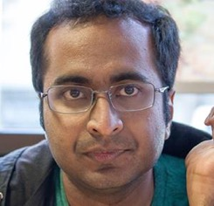
Paris Performance Aware Runtime Inference System
Neeraja Yadwadkar
Bharath
Hariharan
Randy Katz
What vm-type should I use to run my experiment?
r3.2xlarge
m4.large
r3.xlarge
c4.large
t2.large
m4.4xlarge
r3.large
m3.xlarge
g2.8xlarge
m4.2xlarge
g2.2xlarge
m3.2xlarge
m3.medium
t2.micro
c4.xlarge
c4.2xlarge
m3.large
r3.8xlarge
c4.4xlarge
r3.4xlarge
c4.8xlarge
t2.small
m4.xlarge
x1.32xlarge
t2.medium
t2.nano
m4.10xlarge

Slide 5
Paris Performance Aware Runtime Inference System
Neeraja Yadwadkar
Bharath
Hariharan
Randy Katz
What vm-type should I use to run my experiment?
Answer: workload specific and depends on cost & runtime goals
c4.large
r3.large
m4.large
t2.small
t2.micro
t2.large
r3.xlarge
m4.2xlarge
c4.4xlarge
m3.xlarge
m3.large
g2.2xlarge
r3.8xlarge
c4.8xlarge
g2.8xlarge
t2.medium
m4.10xlarge
c4.2xlarge
m4.xlarge
c4.xlarge
m3.medium
t2.nano
r3.4xlarge
m3.2xlarge
x1.32xlarge
m4.4xlarge
r3.2xlarge
54
25
18

Slide 6
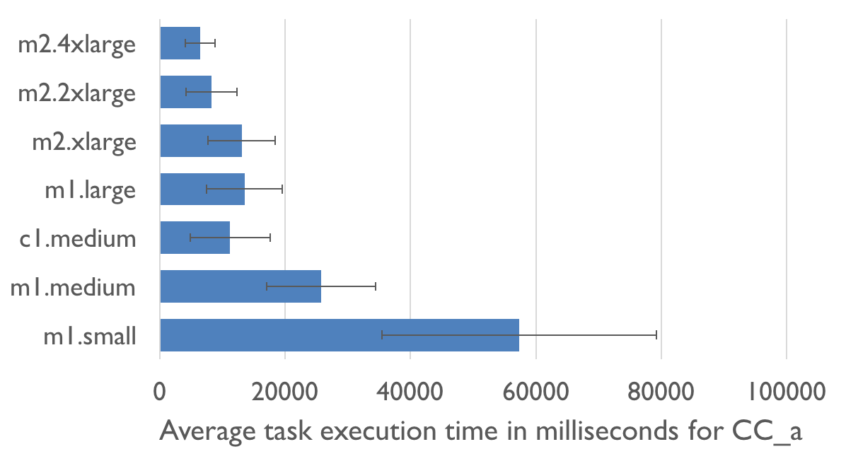
Paris Performance Aware Runtime Inference System
Neeraja Yadwadkar
Bharath
Hariharan
Randy Katz
Best vm-type depends on workload as well as cost & runtime goals
Which VM will cost me the least?
Price
Runtime
m1.small is cheapest?

Slide 7
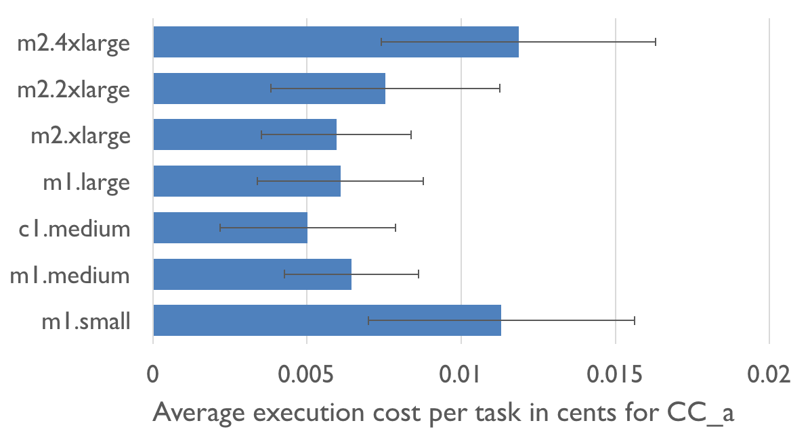
Paris Performance Aware Runtime Inference System
Neeraja Yadwadkar
Bharath
Hariharan
Randy Katz
Best vm-type depends on workload as well as cost & runtime goals
Price
Job Cost
Runtime
Requires accurate runtime prediction.

Slide 8
Paris Performance Aware Runtime Inference System
Neeraja Yadwadkar
Bharath
Hariharan
Randy Katz
Goal: Predict the runtime of workload w on VM type v
Challenge: How do we model workloads and VM types
Insight:
Extensive benchmarking to model relationships between VM types
Costly but run once for all workloads
Lightweight workload “fingerprinting” by on a small set of test VMs
Generalize workload performance on other VMs
Results: Runtime prediction 17% Relative RMSE (56% Baseline)
Benchmarking
…
vm1
vm2
vm100
Fingerprinting
Workload

Slide 9



Hemingway* Modeling Throughput and Convergence for ML Workloads
Shivaram
Venkataraman
Xinghao
Pan
Zi
Zheng
What is the best algorithm and level of parallelism for an ML task?
Trade-off: Parallelism, Coordination, & Convergence
Research challenge: Can we model this trade-off explicitly?
ML Metric
We can estimate I from data on many systems
Iter. / Sec.
Loss
p=1
Systems Metric
We can estimate L from data for our problem
p=4
Cores
Iteration
Iterations per second as a function of cores p
Loss as a function of iterations i and cores p
*follow-up work to Shivaram’s Ernest paper
Notes:
more parallelism doesn’t not imply faster learning
can depend on loss and properties of the data

Slide 10
Hemingway* Modeling Throughput and Convergence for ML Workloads
Shivaram
Venkataraman
Xinghao
Pan
Zi
Zheng
What is the best algorithm and level of parallelism for an ML task?
Trade-off: Parallelism, Coordination, & Convergence
Research challenge: Can we model this trade-off explicitly?
Loss as a function of iterations i and cores p
Iterations per second as a function of cores p
How long does it take to get to a given loss?
Given a time budget and number of cores which algorithm will give the best result?
*follow-up work to Shivaram’s Ernest paper
Notes:
more parallelism doesn’t not imply faster learning
can depend on loss and properties of the data

Slide 11

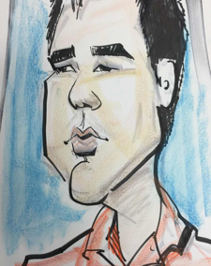

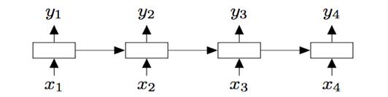
Deep Code Completion Neural architectures for reasoning about programs
Goals:
Smart naming of variables and routines
Learn coding styles and patterns
Predict large code fragments
Char and Symbol LSTMs
Programs are more tree shaped…
Xin
Wang
Chang
Liu
Dawn
Song
def fib( ):
x
if
x < 2
:
return x
else:
y
=
fib(x–1)
+
fib(x–2)
return y
Notes:
more parallelism doesn’t not imply faster learning
can depend on loss and properties of the data

Slide 12
Deep Code Completion Neural architectures for reasoning about programs
Goals:
Smart naming of variables and routines
Learn coding styles and patterns
Predict large code fragments
Char and Symbol LSTMs
Programs are more tree shaped…
Xin
Wang
Chang
Liu
Dawn
Song
def fib( ):
x
Parse
Tree
if
x < 2
return x
=
y
+
fib(x–1)
fib(x–2)
return y
Notes:
Improved Semantic Representations From Tree-Structured Long Short-Term Memory Networks
Kai Sheng Tai, Richard Socher, Christopher D. Manning

Slide 13
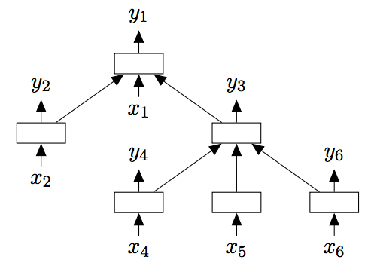
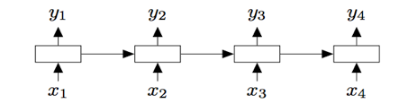
Deep Code Completion Neural architectures for reasoning about programs
Goals:
Smart naming of variables and routines
Learn coding styles and patterns
Predict large code fragments
Char and Symbol LSTMs
Exploring Tree LSTMs
Issue: dependencies flow in both directions
Xin
Wang
Chang
Liu
Dawn
Song
def fib( ):
x
Parse
Tree
if
x < 2
return x
=
y
+
fib(x–1)
fib(x–2)
return y
Kai Sheng Tai, Richard Socher, Christopher D. Manning. “Improved Semantic Representations From Tree-Structured Long Short-Term Memory Networks.” (ACL 2015)
Notes:
Improved Semantic Representations From Tree-Structured Long Short-Term Memory Networks
Kai Sheng Tai, Richard Socher, Christopher D. Manning

Slide 14
How can machine learning techniques be used to address systems challenges?
Learning Systems
How can systems techniques be used to address machine learning challenges?

Slide 15
How can machine learning techniques be used to address systems challenges?
Learning Systems
How can systems techniques be used to address machine learning challenges?

Slide 16
Systems for Machine Learning
Big
Data
Training
Big Model
Timescale: minutes to days
Systems: offline and batch optimized
Heavily studied ... primary focus of the ML research

Slide 17
Learning
Big
Data
Training
Big Model
emgine
C
L
C
M

Slide 18
Distributed Analytics Spark.mllib
Big
Data
Training
Big Model
Distributed Execution Engine
Fault-tolerant, efficient in-memory storage
Powerful interactive APIs: Python, Java, Scala
Fast: up to 100x faster than Hadoop MR
Can run sub-second jobs on hundreds of nodes
Easy to use: 2-5x less code than Hadoop MR
General: support interactive & iterative apps
emgine

Slide 19
Example: Logistic Regression
Goal: find best line separating two sets of points
random initial line
+
+
+
+
+
–
+
–
+
+
–
–
+
+
–
–
–
–
–
–
target
Notes:
Note that dataset is reused on each gradient computation

Slide 20
Example: Logistic Regression
Load data in memory once
val data = spark.textFile(...).map(readPoint).cache()
var w = Vector.random(D)
for (i <- 1 to ITERATIONS) {
val gradient = data.map(p =>
(1 / (1 + exp(-p.y*(w dot p.x))) - 1) * p.y * p.x
).reduce(_ + _)
w -= gradient
}
println("Final w: " + w)
Initial parameter vector
Repeated MapReduce steps to do gradient descent
Notes:
Key idea: add “variables” to the “functions” in functional programming

Slide 21
Logistic Regression Performance
110 s / iteration
first iteration 80 s
further iterations 1 s
29 GB dataset on 20 EC2 m1.xlarge machines (4 cores each)
Notes:
This is for a 29 GB dataset on 20 EC2 m1.xlarge machines (4 cores each)

Slide 22
Learning
Big
Data
Training
Big Model
emgine
C
L
C
M

Slide 23
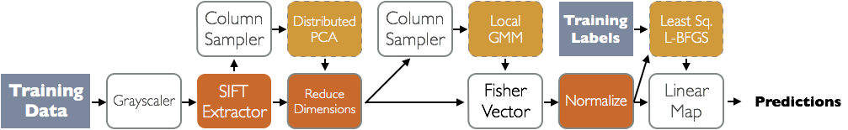
A Framework for Machine Learning Pipelines
Big
Data
Training
Big Model
Learning
E. Sparks, S. Venkataraman, T. Kaftan, M. Franklin, B. Recht
Software framework for describing complex machine learning pipelines built on Apache Spark.
Pipelines are specified using domain specific and general purpose logical learning operators.
Scalable, modular, components yield scalable pipelines.
emgine
C
L
C
M

Slide 24
Learning
Big
Data
Training
Big Model
emgine

Slide 25
A Distributed Graph Analytics Engine
Big
Data
Training
Learning
Big Model
J. Gonzalez, R. Xin, A. Dave, D. Crankshaw, M. Franklin, I. Stoica
Unified computation across tables and graphs:
Enables efficient execution of graphical ML algorithms
Ships as part of Apache Spark
Post
Classification
Social
Network
Political
Bias Estimation
Predicted
User Bias
User
Disc.
User
Bias
emgine

Slide 26
Learning
Big
Data
Training
Big Model
emgine

Slide 27
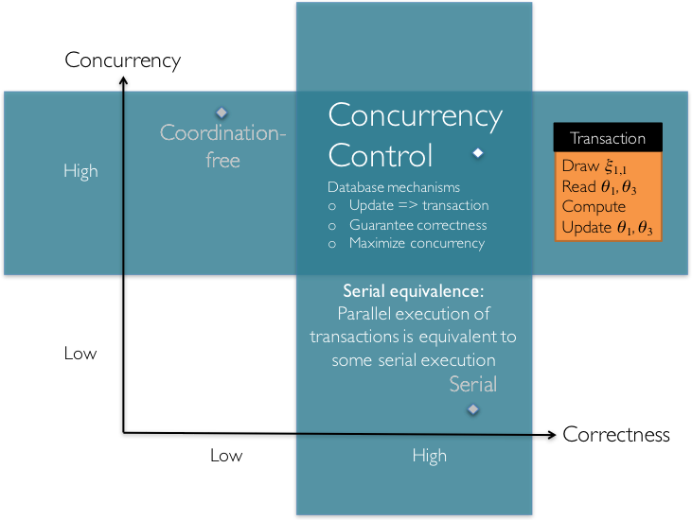
Concurrency Control for Machine Learning
Big
Data
Training
Learning
Big Model
Xinghao Pan et. al
Design of parallel machine learning algorithms using various concurrency control techniques
emgine

Slide 28
Learning
Big
Data
Training
Big Model
emgine

Slide 29
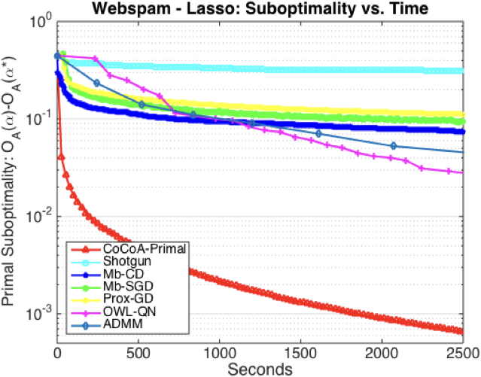
A Framework for Distributed Optimization
Big
Data
Training
Big Model
Learning
V. Smith, S. Forte, C. Ma, M. Takáč, M. Jaggi, M. I. Jordan
Challenge: distributed optimization and ML is often communication bound
Solution: CoCoA reduces communication by
exploiting the primal-dual setting to leverage efficient local solvers
Provide strong convergence guarantees & empirical results
Open-source implementation in Spark, Flink, and TensorFlow
emgine

Slide 30
Learning
Big
Data
Training
Big Model
emgine

Slide 31
A Scalable Multivariate Time Series Analysis Engine
Big
Data
Training
Big Model
emgine
F. Belletti, E. Sparks, X. Wang, I. Stoica
Challenge:
Estimate second order statistics
E.g. Auto-correlation, auto-regressive models, …
for high-dimensional & irregularly sampled time series
Regularly
Sampled
Irregularly
Sampled
Samples are easy to align (requires sorting)
Difficult to align!

Slide 32
A Scalable Multivariate Time Series Analysis Engine
emgine
F. Belletti, E. Sparks, X. Wang, I. Stoica
Challenge:
Estimate second order statistics
E.g. Auto-correlation, auto-regressive models, …
for high-dimensional & irregularly sampled time series
Regularly
Sampled
Irregularly
Sampled
Solution:
Project onto Fourier basis
does not require data alignment
Infer statistics in frequency domain
equivalent to kernel smoothing
analysis of bias – variance tradeoff
Samples are easy to align (requires sorting)
Difficult to align!

Slide 33
A Scalable Multivariate Time Series Analysis Engine
emgine
F. Belletti, E. Sparks, X. Wang, I. Stoica
Challenge:
Estimate second order statistics
E.g. Auto-correlation, auto-regressive models, …
for high-dimensional & irregularly sampled time series
Regularly
Sampled
Solution:
Project onto Fourier basis
does not require data alignment
Infer statistics in frequency domain
equivalent to kernel smoothing
analysis of bias – variance tradeoff
Irregularly
Sampled
emgine
Difficult to align!
Requires aligning samples in time to compute correlation
Define an operator DAG (like TF) and then rely on query-optimization to define efficient execution.

Slide 34
Learning
Big
Data
Training
Big Model

Slide 35
Learning
Inference
Big
Data
Query
Training
?
Decision
Big Model
Application

Slide 36
Inference
Learning
Query
Big
Data
Training
Decision
Big Model
Application
Timescale: ~10 milliseconds
Systems: online and latency optimized
Focus of the new RISE Lab

Slide 37
why is challenging?
Inference
Need to render low latency (< 10ms) predictions for complex
Models
Queries
Features
SELECT * FROM
users JOIN items, click_logs, pages WHERE …
Top K
under heavy load with system failures.

Slide 38
Learning
Inference
Big
Data
Query
Training
Decision
Big Model
Application
Feedback

Slide 39
Learning
Inference
Training
Decision
Big
Data
Timescale: hours to weeks
Issues: Implicit feedback, bias, …
Focus of the new RISE Lab
Application
Feedback

Slide 40
Learning
Inference
Big
Data
Query
Training
Decision
Big Model
Application
Feedback

Slide 41
Learning
Inference
Big
Data
Query
Training
Responsive
(~10ms)
Adaptive
(~1 seconds)
Decision
Big Model
Application
Feedback
Notes:
Adaptive is hard because of the complex training process that typically revisits the entire data set.
Responsive is hard because of complex often personalized models a elaborate queries

Slide 42
Learning
Inference
Adaptive
(~1 seconds)
Responsive
(~10ms)
Techniques we are studying (or should be …):
Multi-task
Learning
Adaptive
Batching
Approx.
Caching
Anytime
Inference
Model
Switching
Meta-Policy
RL
Online Ensemble
Learning
Load Shedding
Model
Compression
Inference on the Edge
Notes:
Adaptive is hard because of the complex training process that typically revisits the entire data set.
Responsive is hard because of complex often personalized models a elaborate queries

Slide 43



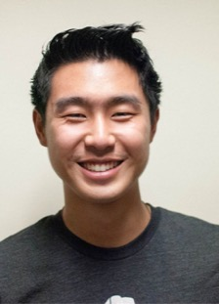
Prediction Serving
Daniel
Crankshaw
Xin
Wang
Giulio
Zhou
Michael
Franklin
Ion Stoica

Slide 44
Learning
Inference
Big
Data
Query
Training
Decision
Application
Feedback

Slide 45
Learning
Inference
Slow Changing
Parameters
Fast Changing Parameters
Big
Data
Query
Feedback
Training
Fast
Decision
Application
Feedback
Slow

Slide 46

Hybrid Offline + Online Learning
Update feature functions offline using batch solvers
Leverage high-throughput systems (Tensor Flow)
Exploit slow change in population statistics
Update the user weights online:
Simple to train + more robust model
Address rapidly changing user statistics

Slide 47
Common modeling structure
Matrix Factorization
Deep Learning
Ensemble
Methods
Items
Users
Ratings
Input

Slide 48
Learning
Inference
Big
Data
Slow Changing
Parameters
Fast Changing Parameters
Feedback
Fast
Application
Feedback
Slow

Slide 49
Learning
Inference
Slow Changing
Parameters
Clipper
Fast Changing Parameters
Big
Data
Feedback
Fast
Caffe
Application
Feedback
Slow

Slide 50
R SE
Real-time, Intelligent, and Secure
Systems Lab

Slide 51
RISE Lab
From live data to real-time decisions
AMP Lab
From batch data to advanced analytics

Slide 52
Goal
Real-time decisions
decide in ms
on live data
the current state as data arrives
with strong security
privacy, confidentiality, and integrity
decide in ms
the current state of the environment
privacy, confidentiality, integrity

Slide 53
R SE
Real-time, Intelligent, and Secure
Systems Lab
Learn More:
CS294 Course on RISE Topics
https://ucbrise.github.io/cs294-rise-fa16/
Early RISErs Seminar on Mondays at 9:30 AM

